Slide 1
PWM Drawer
Ahmed Mady

Slide 2
Project
The project involves an AVR microcontroller-based program that captures rising and falling edges of an input square wave using timer interrupts, calculates the frequency and duty cycle of the waveform, and displays the information on an OLED display using the u8g2 library. The code continuously loops through the waveform capture and display process, providing real-time updates on the duty cycle variations of the input signal.

Slide 3
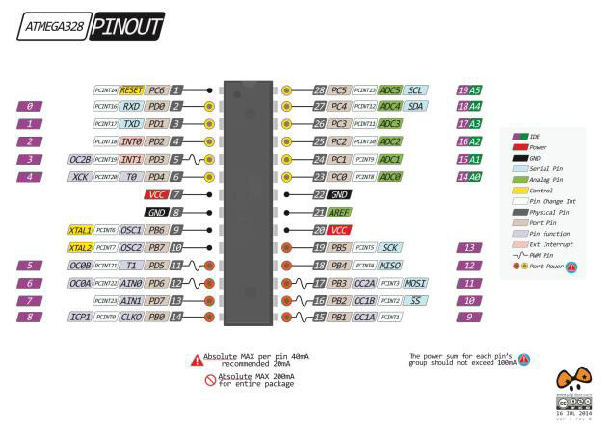
ATMega328P
Modified Harvard architecture.
Typically operates at up to 20 MHz with an external crystal oscillator.
32 KB of in-system self-programmable flash memory.
2 KB of Static Random-Access Memory (SRAM) for volatile data storage.
Two 8-bit timers (Timer/Counter 0 and Timer/Counter 2).
One 16-bit timer (Timer/Counter 1).
UART (Universal Asynchronous Receiver-Transmitter).
SPI (Serial Peripheral Interface).
I2C (Inter-Integrated Circuit).
6 Pulse Width Modulation (PWM) channels available on specific pins.
Two external interrupts.

Slide 4
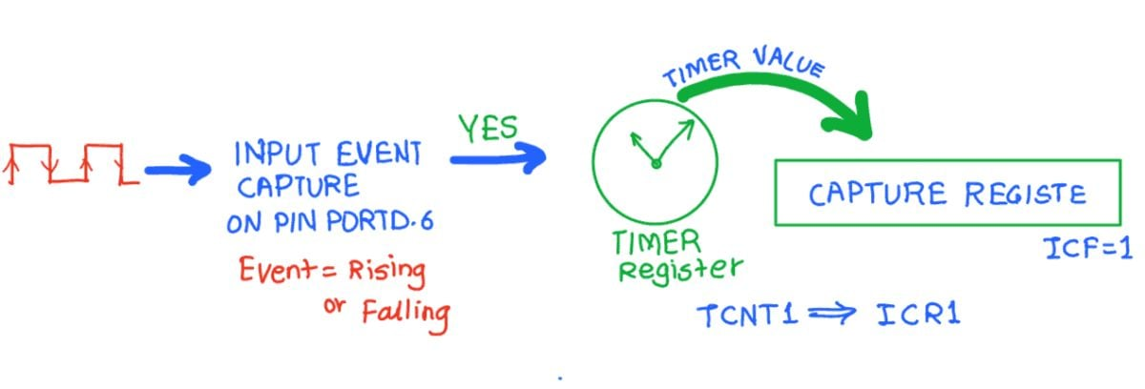
Modules
Input Capture: Input capture is a feature in microcontrollers that allows the precise measurement of the time at which a specific event occurs on an external signal. This event is typically a transition on an external pin, such as a rising or falling edge of a signal.
In the context of microcontrollers like the ATmega328P, which features a timer/counter unit with input capture capability, the input capture function involves capturing the value of the timer/counter at the exact moment when the specified event occurs on the external pin. This captured value is then used to calculate the time between two events, enabling accurate time measurements.
Input capture is commonly used for tasks such as measuring the frequency or duty cycle of a signal, capturing precise timings in external events, or implementing precise time measurements in various applications.

Slide 5
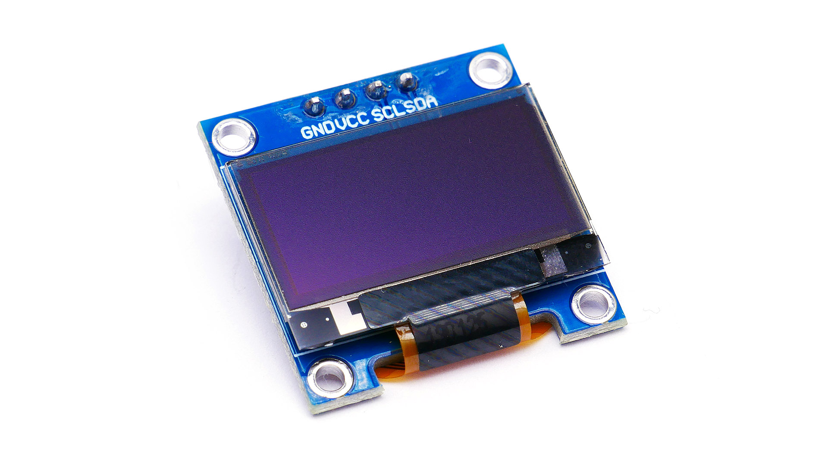
SSD1306: The SSD1306 is a popular monochrome OLED (Organic Light-Emitting Diode) display controller chip widely used in electronic projects. It supports I2C (Inter-Integrated Circuit) communication, which is a serial communication protocol.
The SSD1306 incorporates display RAM, allowing it to directly control the pixels on the OLED display. Its I2C interface simplifies communication between microcontrollers and the display, reducing the number of required pins and making it suitable for projects with limited GPIO resources.
When using I2C with the SSD1306, a microcontroller communicates with the display by sending I2C commands and data. The communication involves addressing the display, specifying commands such as setting the display contrast, activating or deactivating pixels, and updating the content to be displayed.

Slide 6
I2C/ SSD1306 Steps
Initialize I2C:
Set up the microcontroller's I2C hardware and configure the I2C parameters.
Send Start Condition:
Send a start condition on the I2C bus to initiate communication.
Specify SSD1306 Address:
Transmit the SSD1306 I2C address to indicate that subsequent data is intended for the display.
Send Command or Data:
Transmit specific commands or data bytes to configure the SSD1306 settings or update the display content.
Send Stop Condition:
Conclude the I2C communication by sending a stop condition on the bus.

Slide 7
u8g2
String:
u8g2_uint_t u8g2_DrawStr(u8g2_t *u8g2, u8g2_uint_t x, u8g2_uint_t y, const char *str);
Line:
void u8g2_DrawLine(u8g2_t *u8g2, u8g2_uint_t x1, u8g2_uint_t y1, u8g2_uint_t x2, u8g2_uint_t y2);

Slide 8
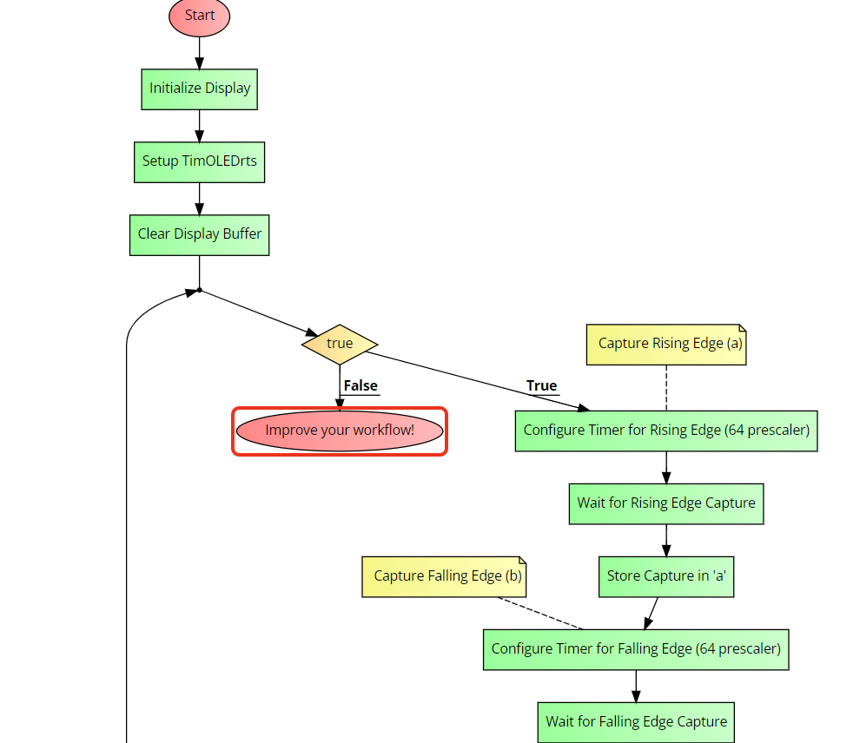

Slide 9
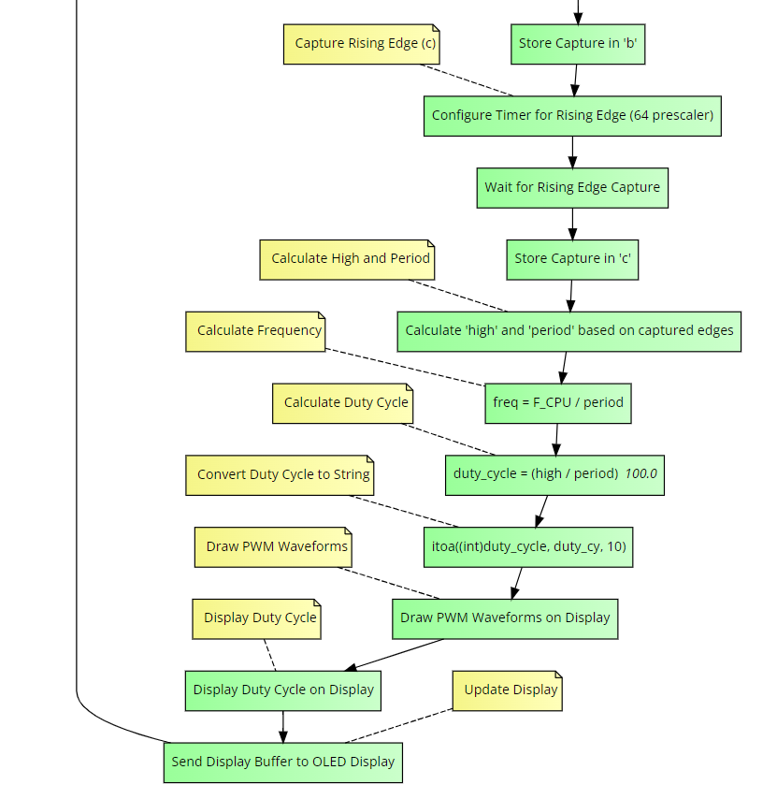

Slide 10
